Slide 1


Wicked Problems: Presentation 1
Professional Capabilities for a Digital World

Slide 2

This session’s roadmap & objectives.
What we will be covering.
Wicked Problems
VUCA Worlds -- Volatility, Uncertainty, Complexity and Ambiguity
Unit Learning Objectives (ULOs).
Review the roles and responsibilities of ICT professionals in organisations and society from a range of perspectives such as work-life balance, mentoring and life-long learning.
What you need to do with this recorded presentation.
Watch, reflect and take your own notes in prep for the investigative case study.
Jot down any queries you may have on the concepts ready for the weekly LIVE catchup classes.
How long will this task take.
This task is expected to take approx. 30-40 minutes to complete.

Slide 3
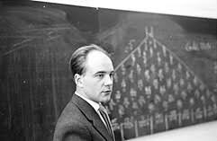
Wicked Problems.
Most social problems—such as inequality, political instability, death, disease, or famine—are wicked
Horst Rittell & Melvin Webber (1973)
Rittell’s Characteristics of Wicked Problems
No definitive formulation
It's hard, maybe impossible, to measure or claim success with wicked problems
Solutions can be only good or bad, not true or false
No wicked problem ‘template’ to follow
Always more than one explanation
Notes:
3
Rittel, H 1973, Dilemmas in a General Theory of Planning, Policy Sciences, pp. 155-169.

Slide 4
Wicked Problems / Cont.
Every wicked problem is a symptom of another problem
No definitive scientific test for any mitigation strategy
A solution can be seen as a one shot which changes the design space (the problem) for the next
All wicked problems are unique
Designers attempting to address a wicked problem must be fully responsible for their actions
Notes:
4
Rittel, H 1973, Dilemmas in a General Theory of Planning, Policy Sciences, pp. 155-169.

Slide 5
Wicked Problems / Cont.
The basic assumption that began the discussion of wicked problems is that making public policies is difficult.
Require a deeper understanding
Complexity theories
Focusing on system interactions
Open systems allowing influences from the outside
Politically and technical complex
Notes:
5

Slide 6
SUPER Wicked Problems.
The nature of significant policy problems facing contemporary governments. Like the concept of wicked problems, this concept also has a number of defining characteristics, in addition to those used to define wicked problems. These characteristics are:
(1) Time is running out;
(2) There is no central authority, or only a weak central authority, to manage the problem
(3) The same actors causing the problem seem to solve it; and
(4) The future is discounted radically so that contemporary solutions become less valuable.
Notes:
6
(Levin, Cashore, & Auld, 2012; see also Lazarus, 2009)

Slide 7
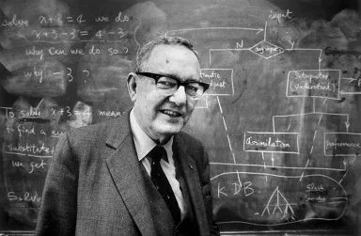
Herbert Simon’s ‘Ill-structured’ Problems.
Simon (1973)
Concerns were with:
The clarity of the definition of the problem
The extent to which it was independent of other problems
The adequacy of the knowledge base for coping with the problem
Notes:
7

Slide 8
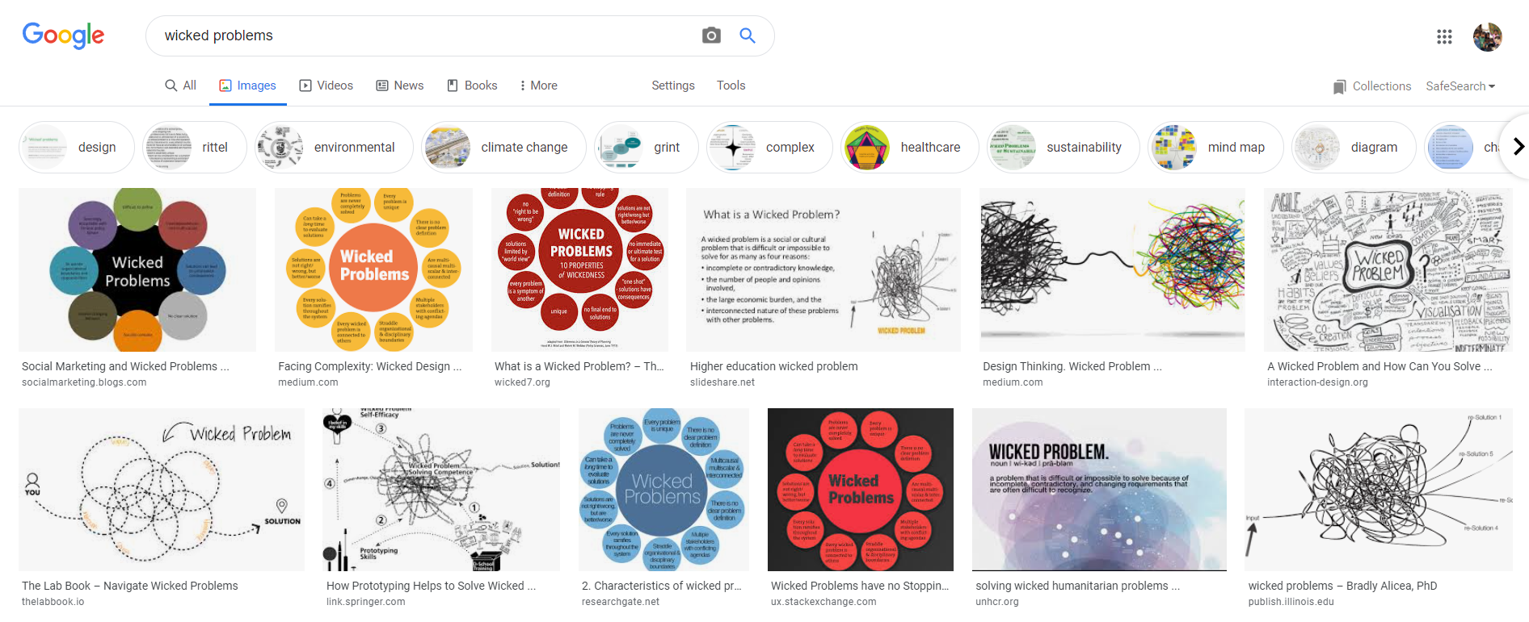
Wicked Problems / Cont.
Notes:
8

Slide 9
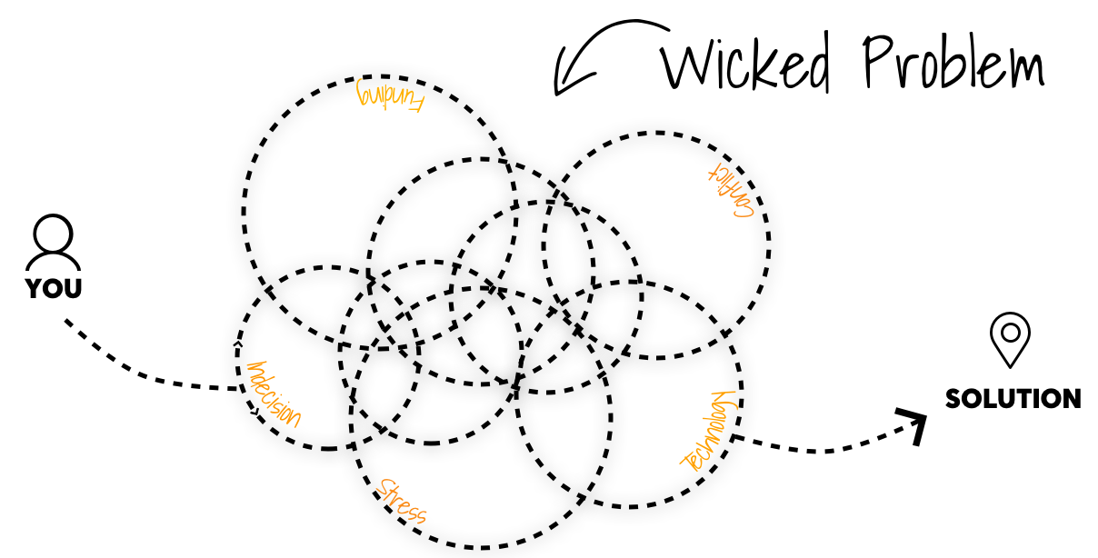
Wicked Problems / Cont.
Imagery
Notes:
9

Slide 10

UN SDGs / Which ones are ‘Wicked’?
Notes:
10

Slide 11
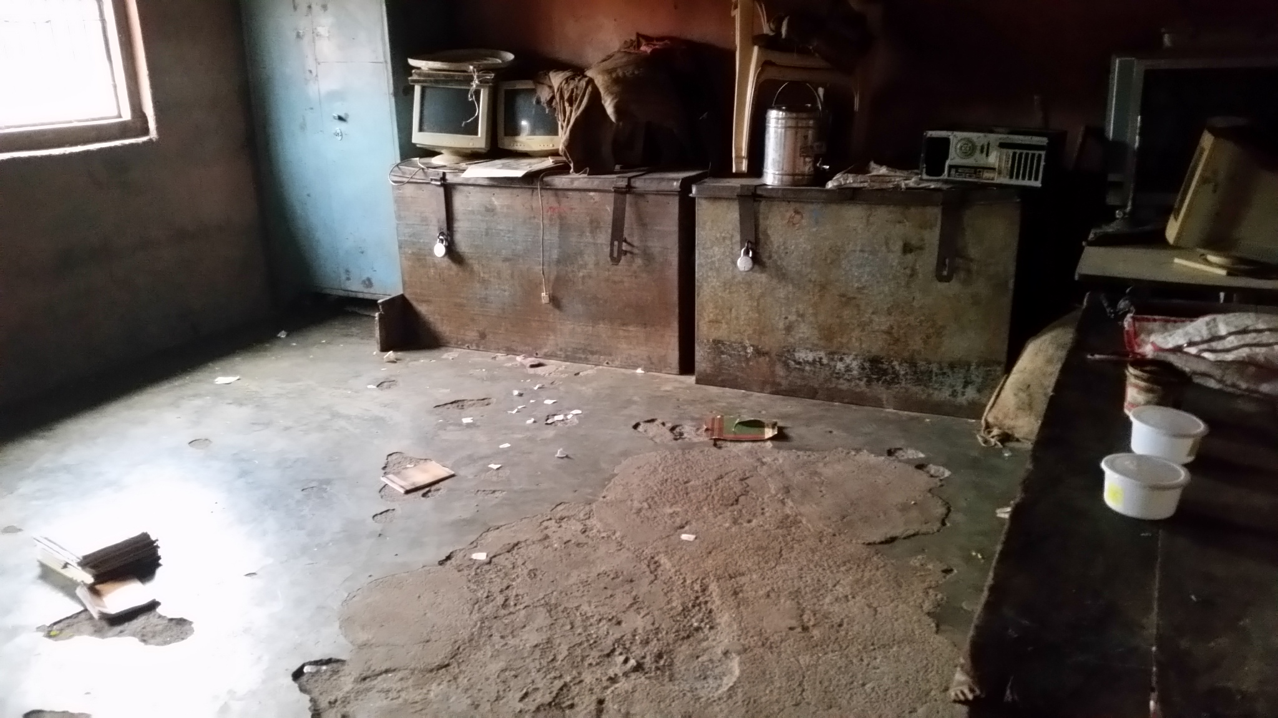
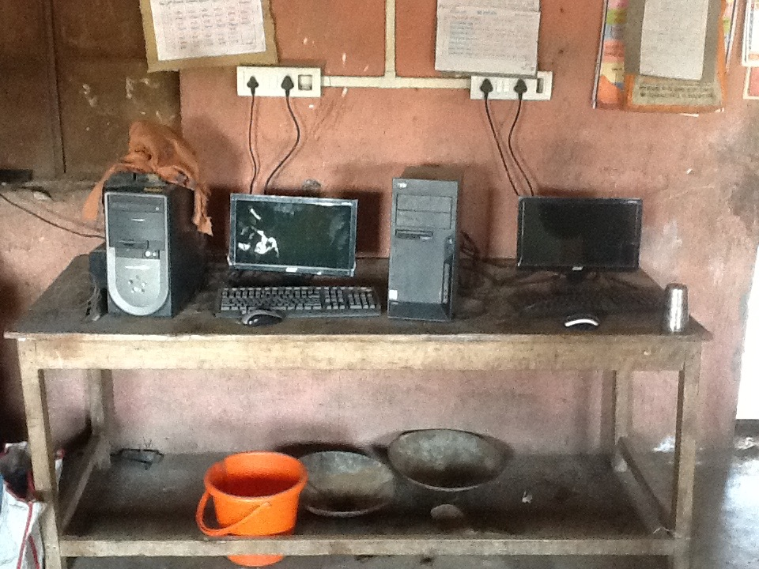
UN SDG #4 / What screams ‘quality’ about this image?
Jamnya School 2014
Notes:
11

Slide 12
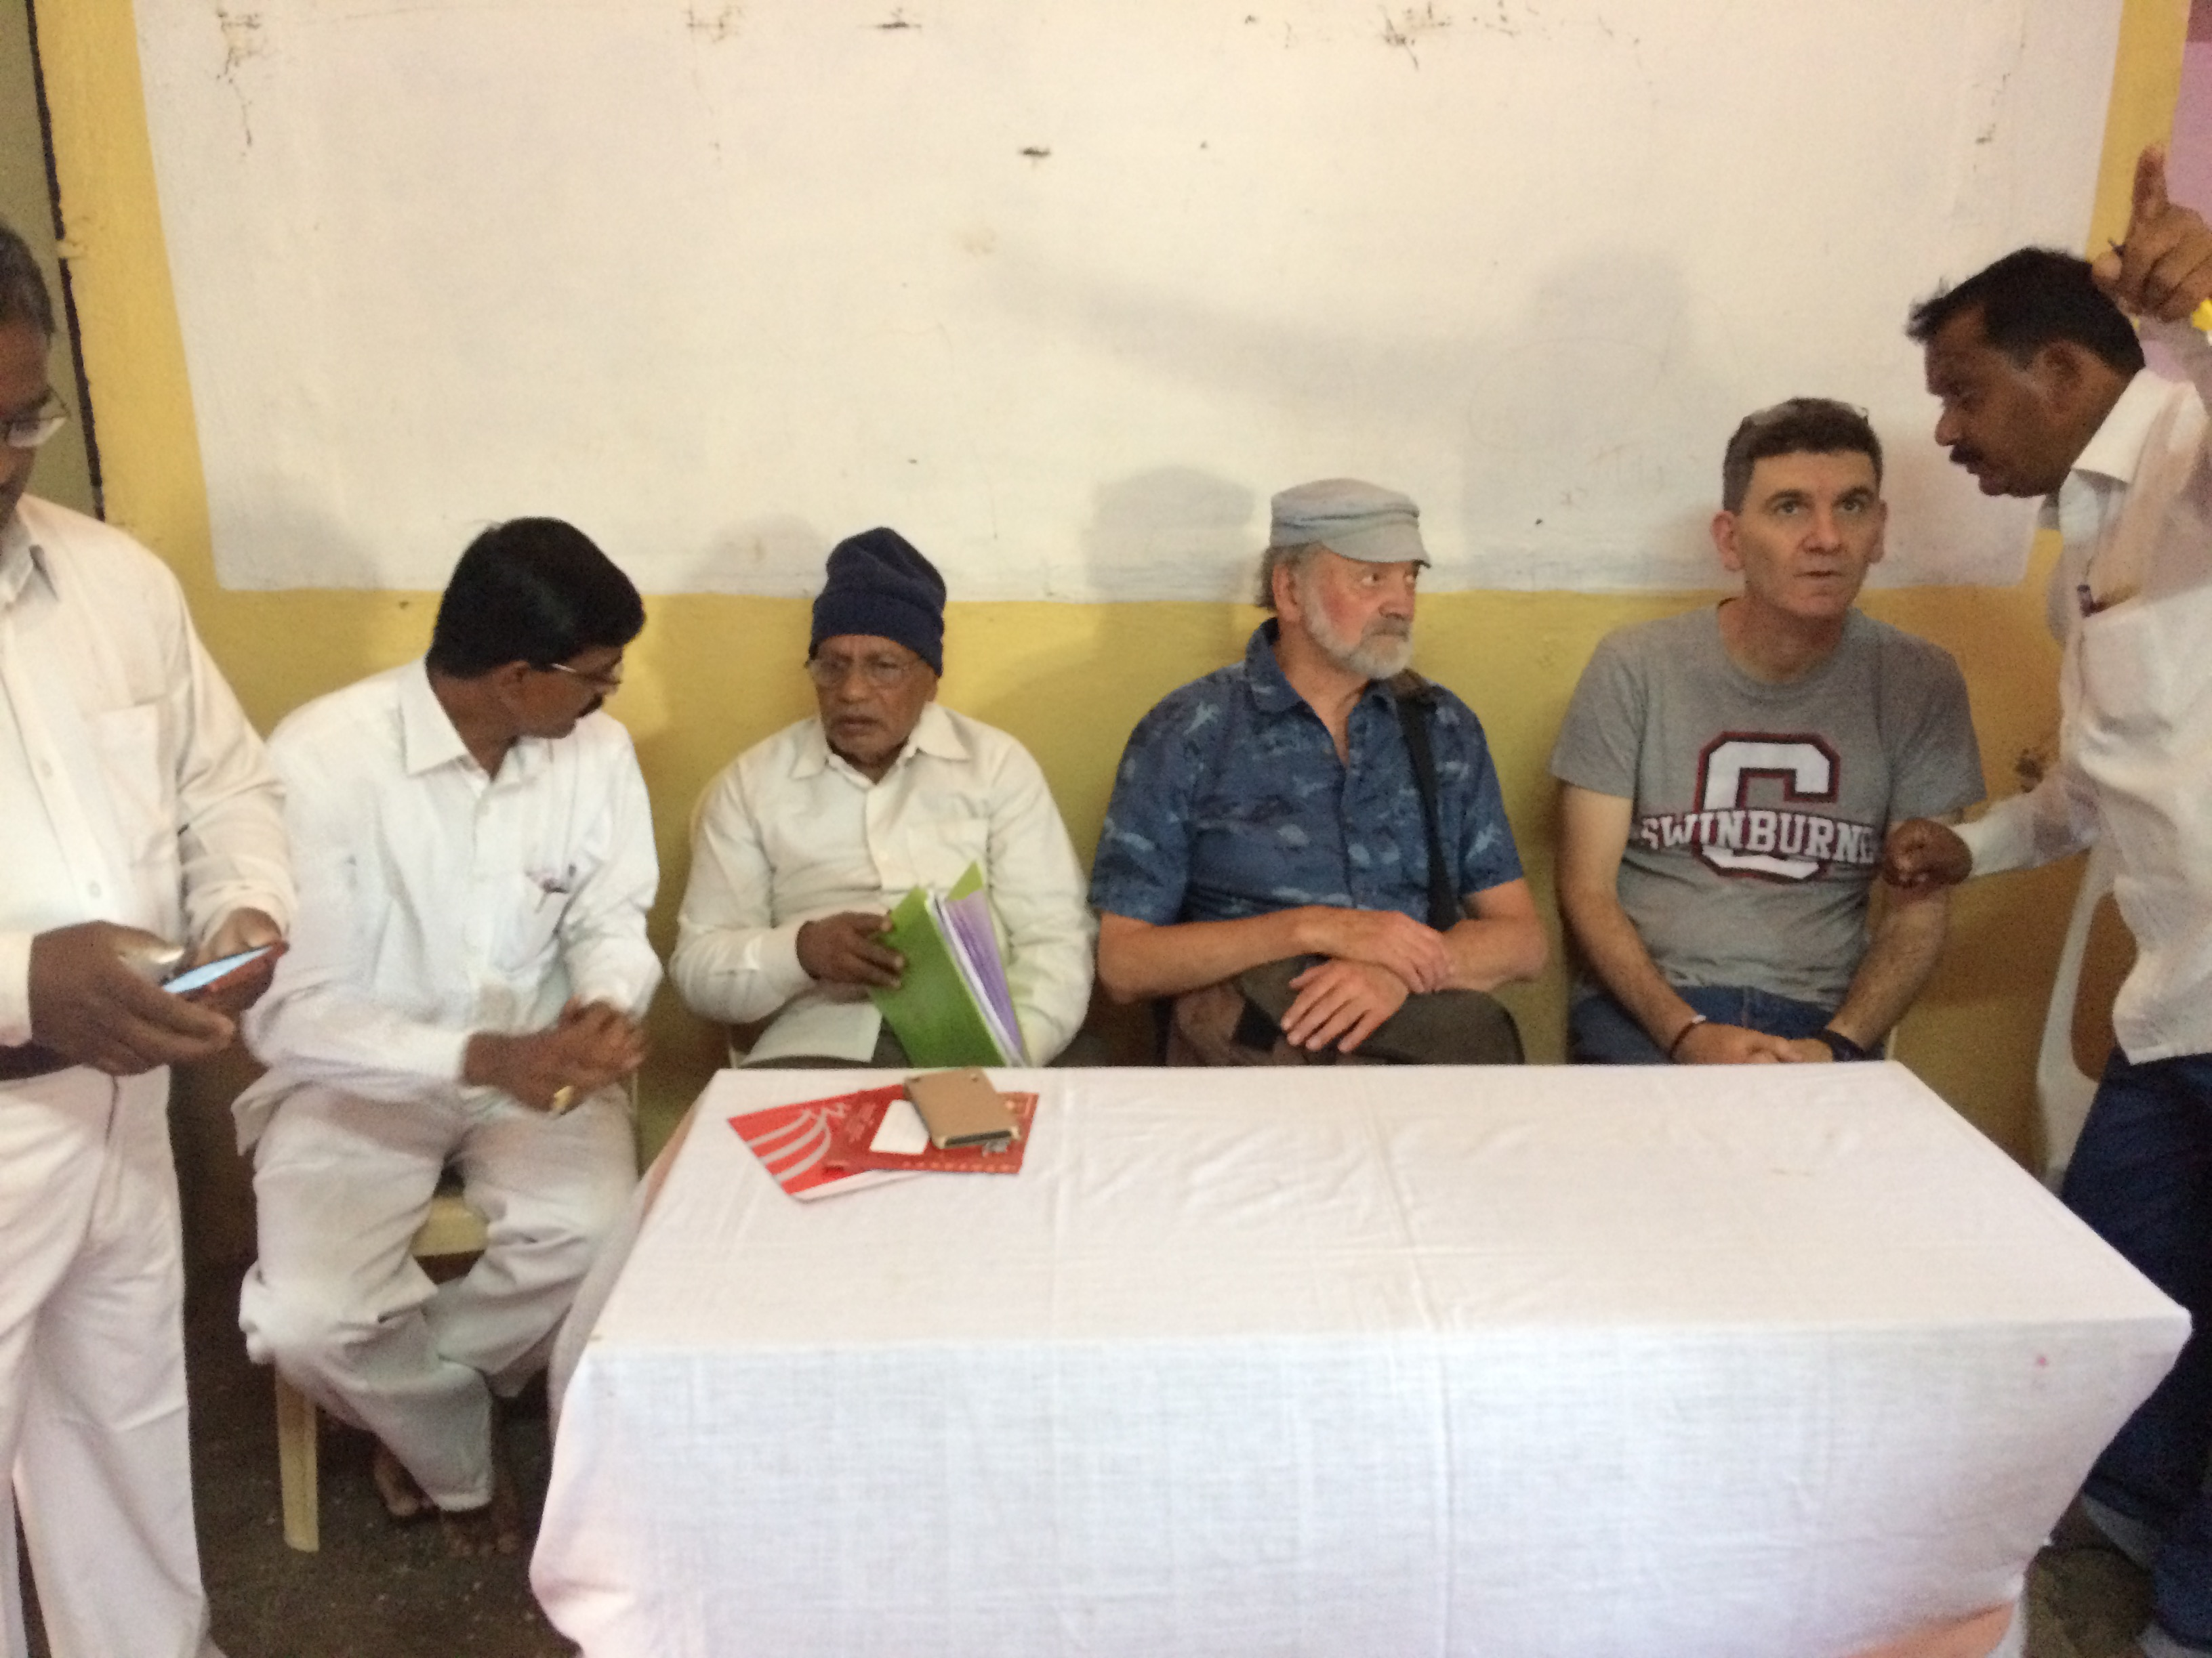
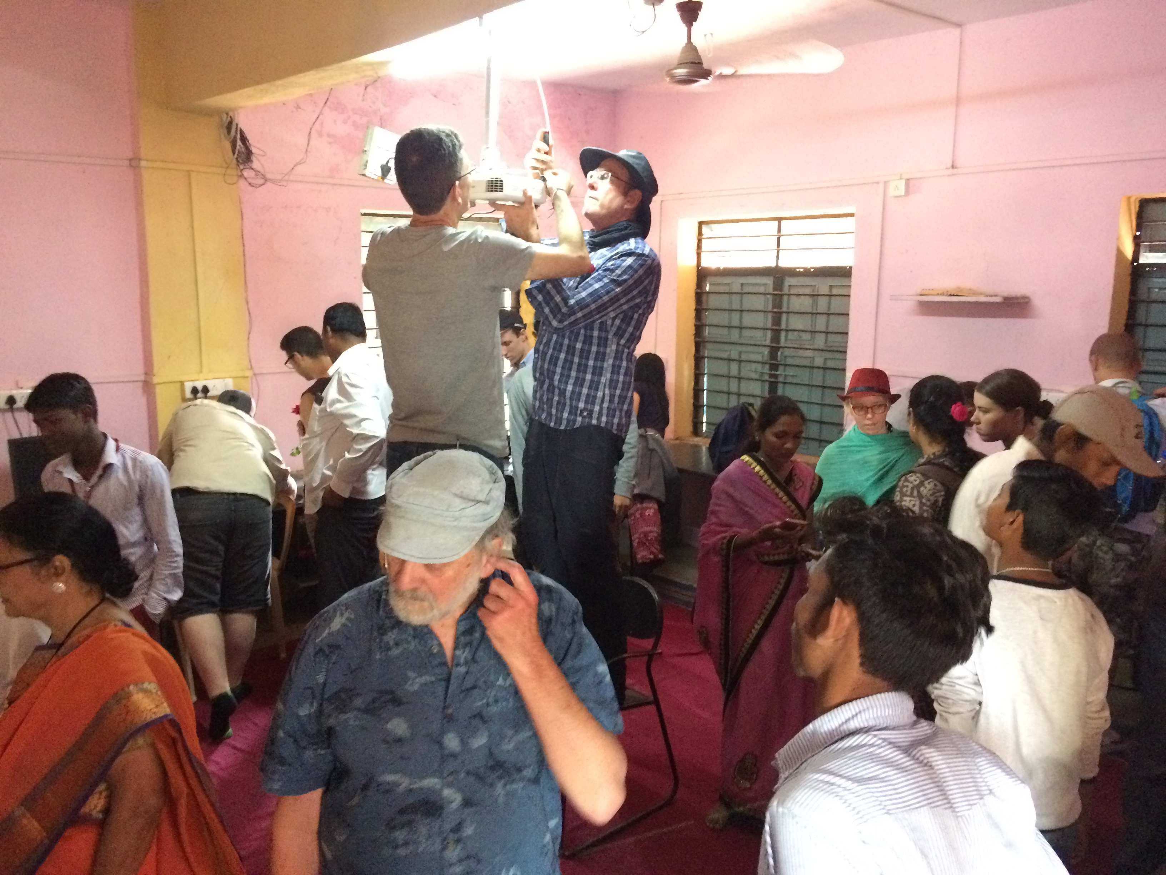
UN SDG #4 / Is ‘quality’ beginning to emerge this image?
Mohamandali School 2017
Notes:
12

Slide 13
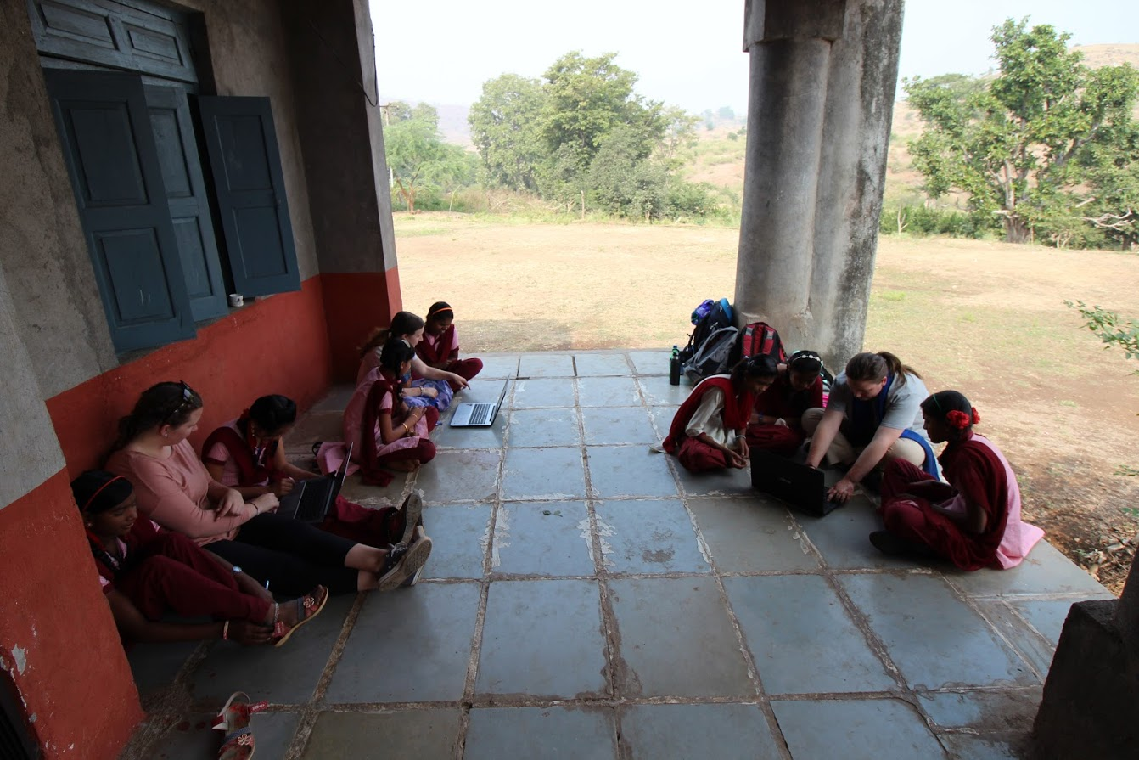
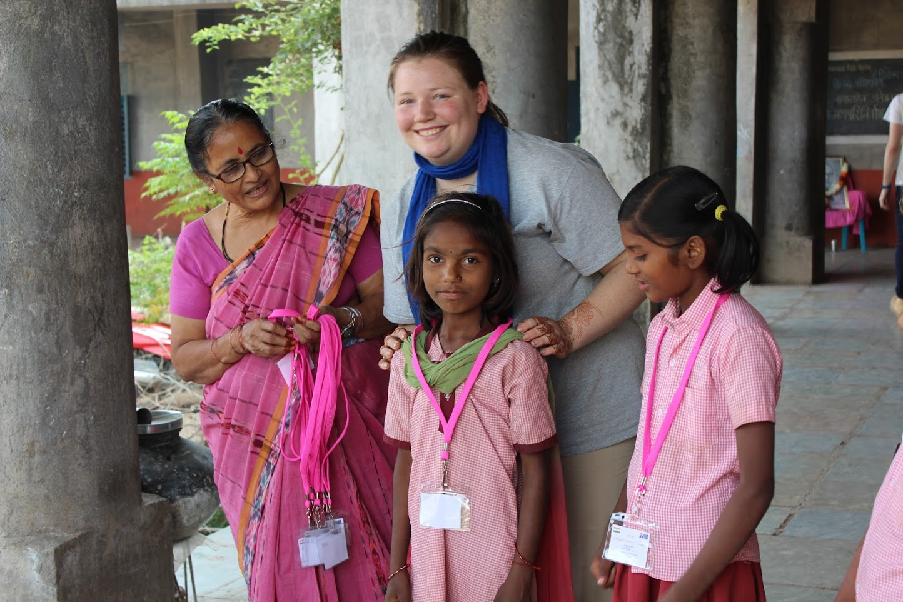
UN SDG #5 / Gender Equality.
Mongral School 2018
Notes:
13

Slide 14
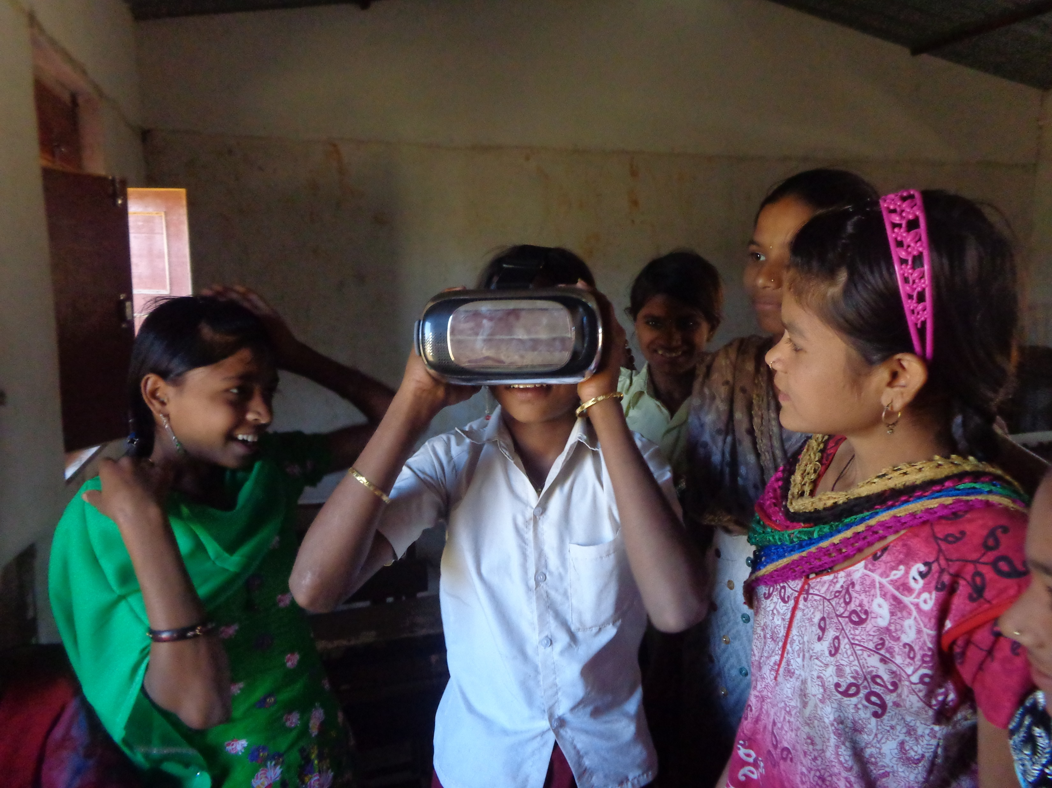
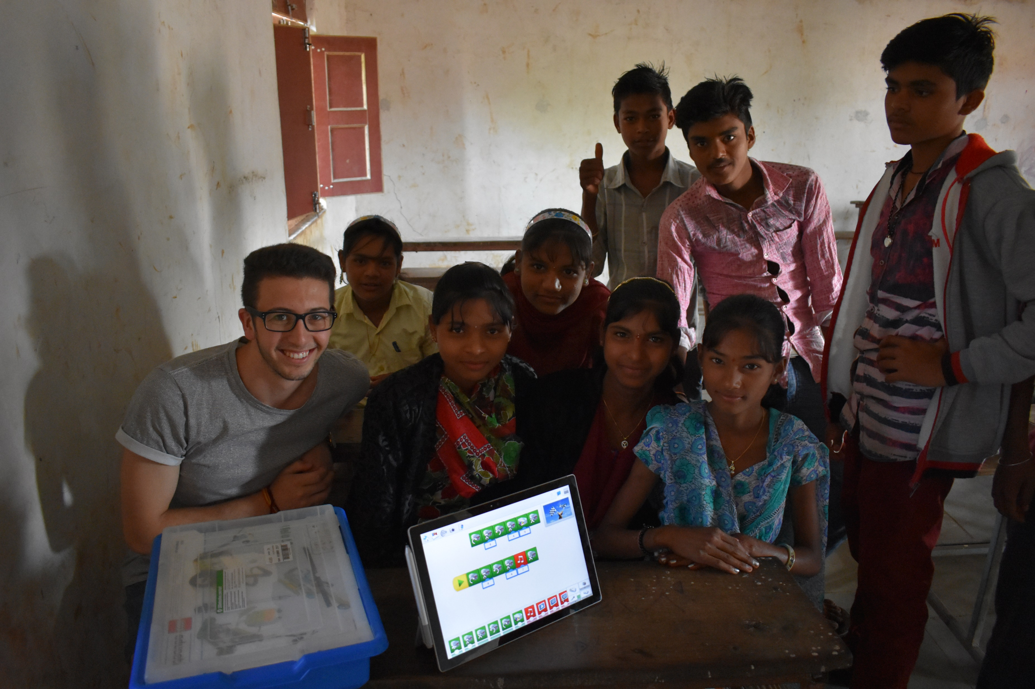
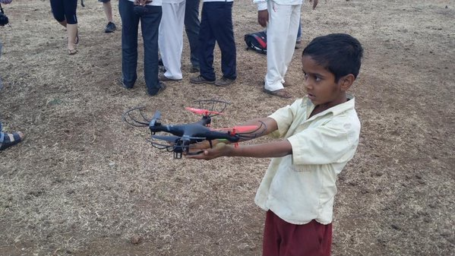
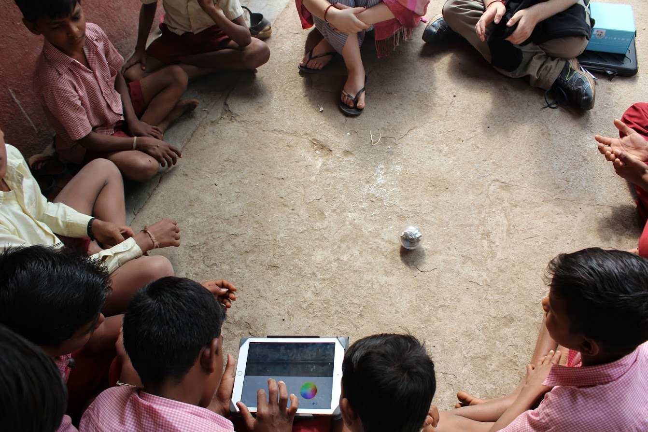
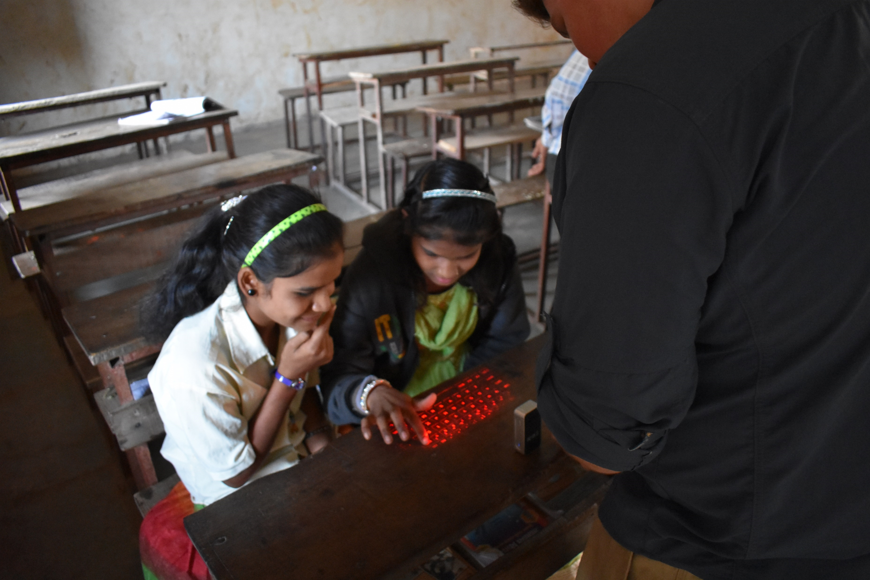
What’s possible/feasible?
What can you ‘put on the table’?
Imagineering with:
VR, Virtual Keyboards, WeDo 2.0, UAVs, SPHERO
Notes:
14

Slide 15
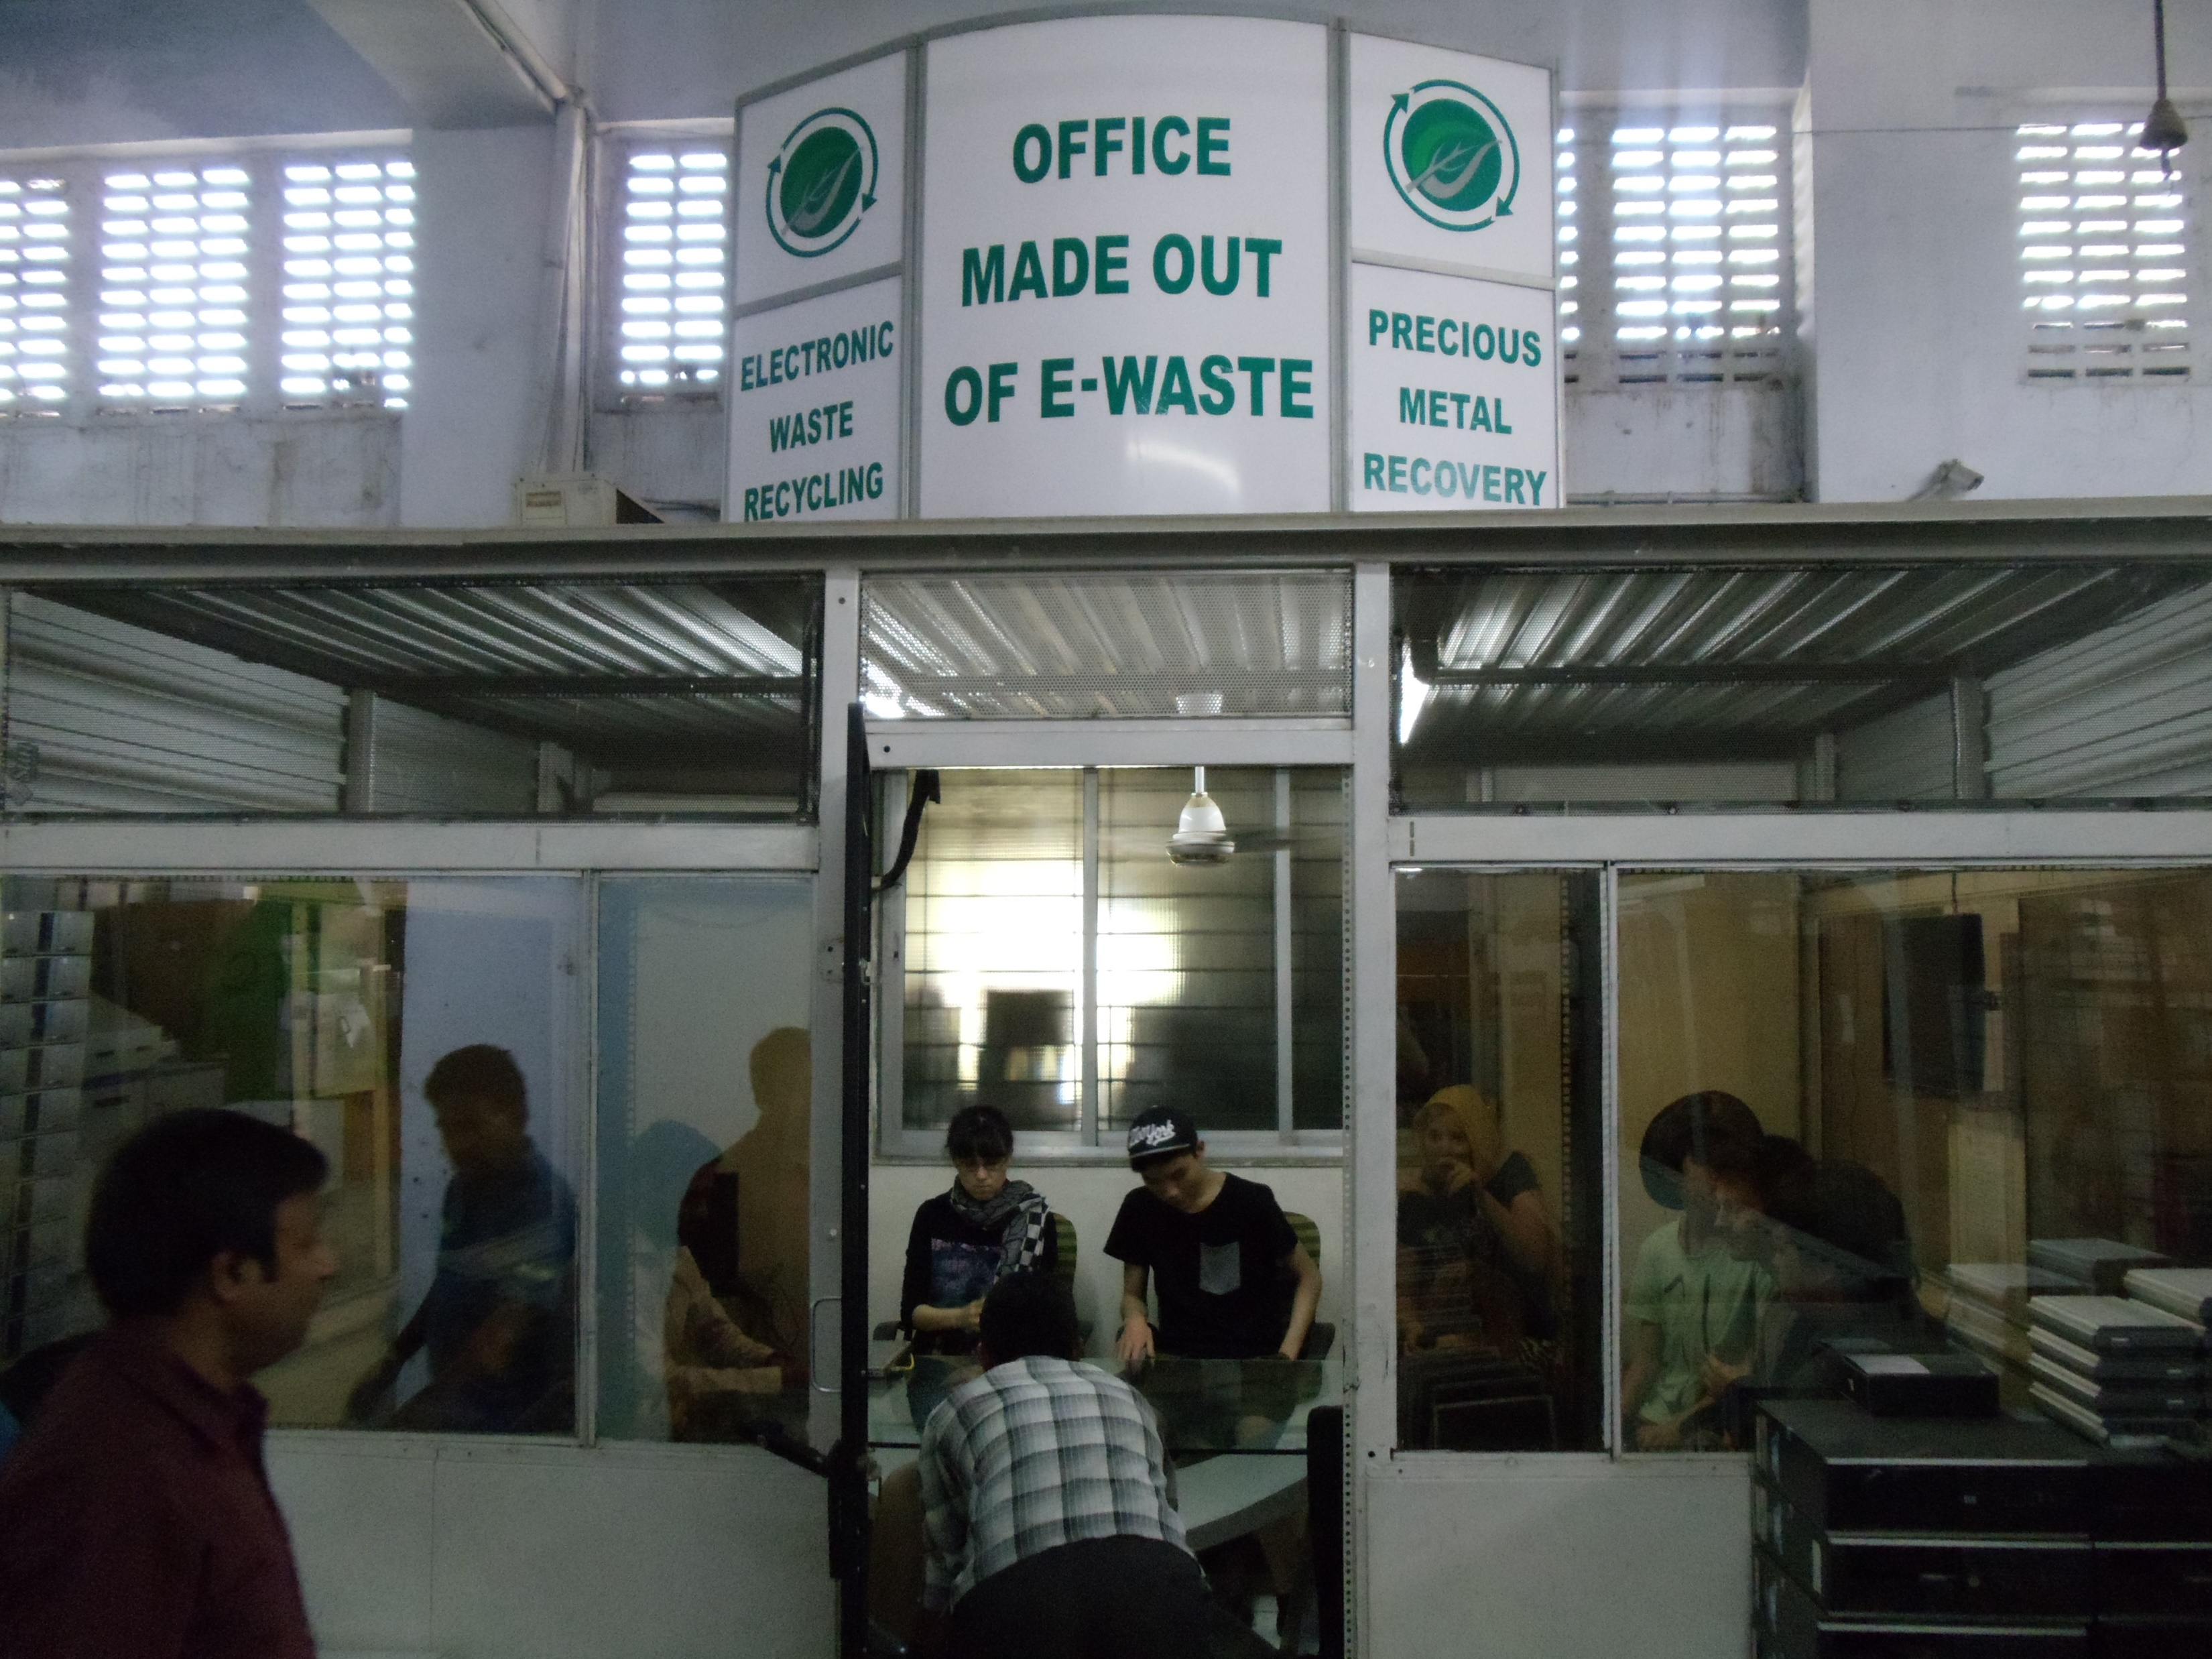
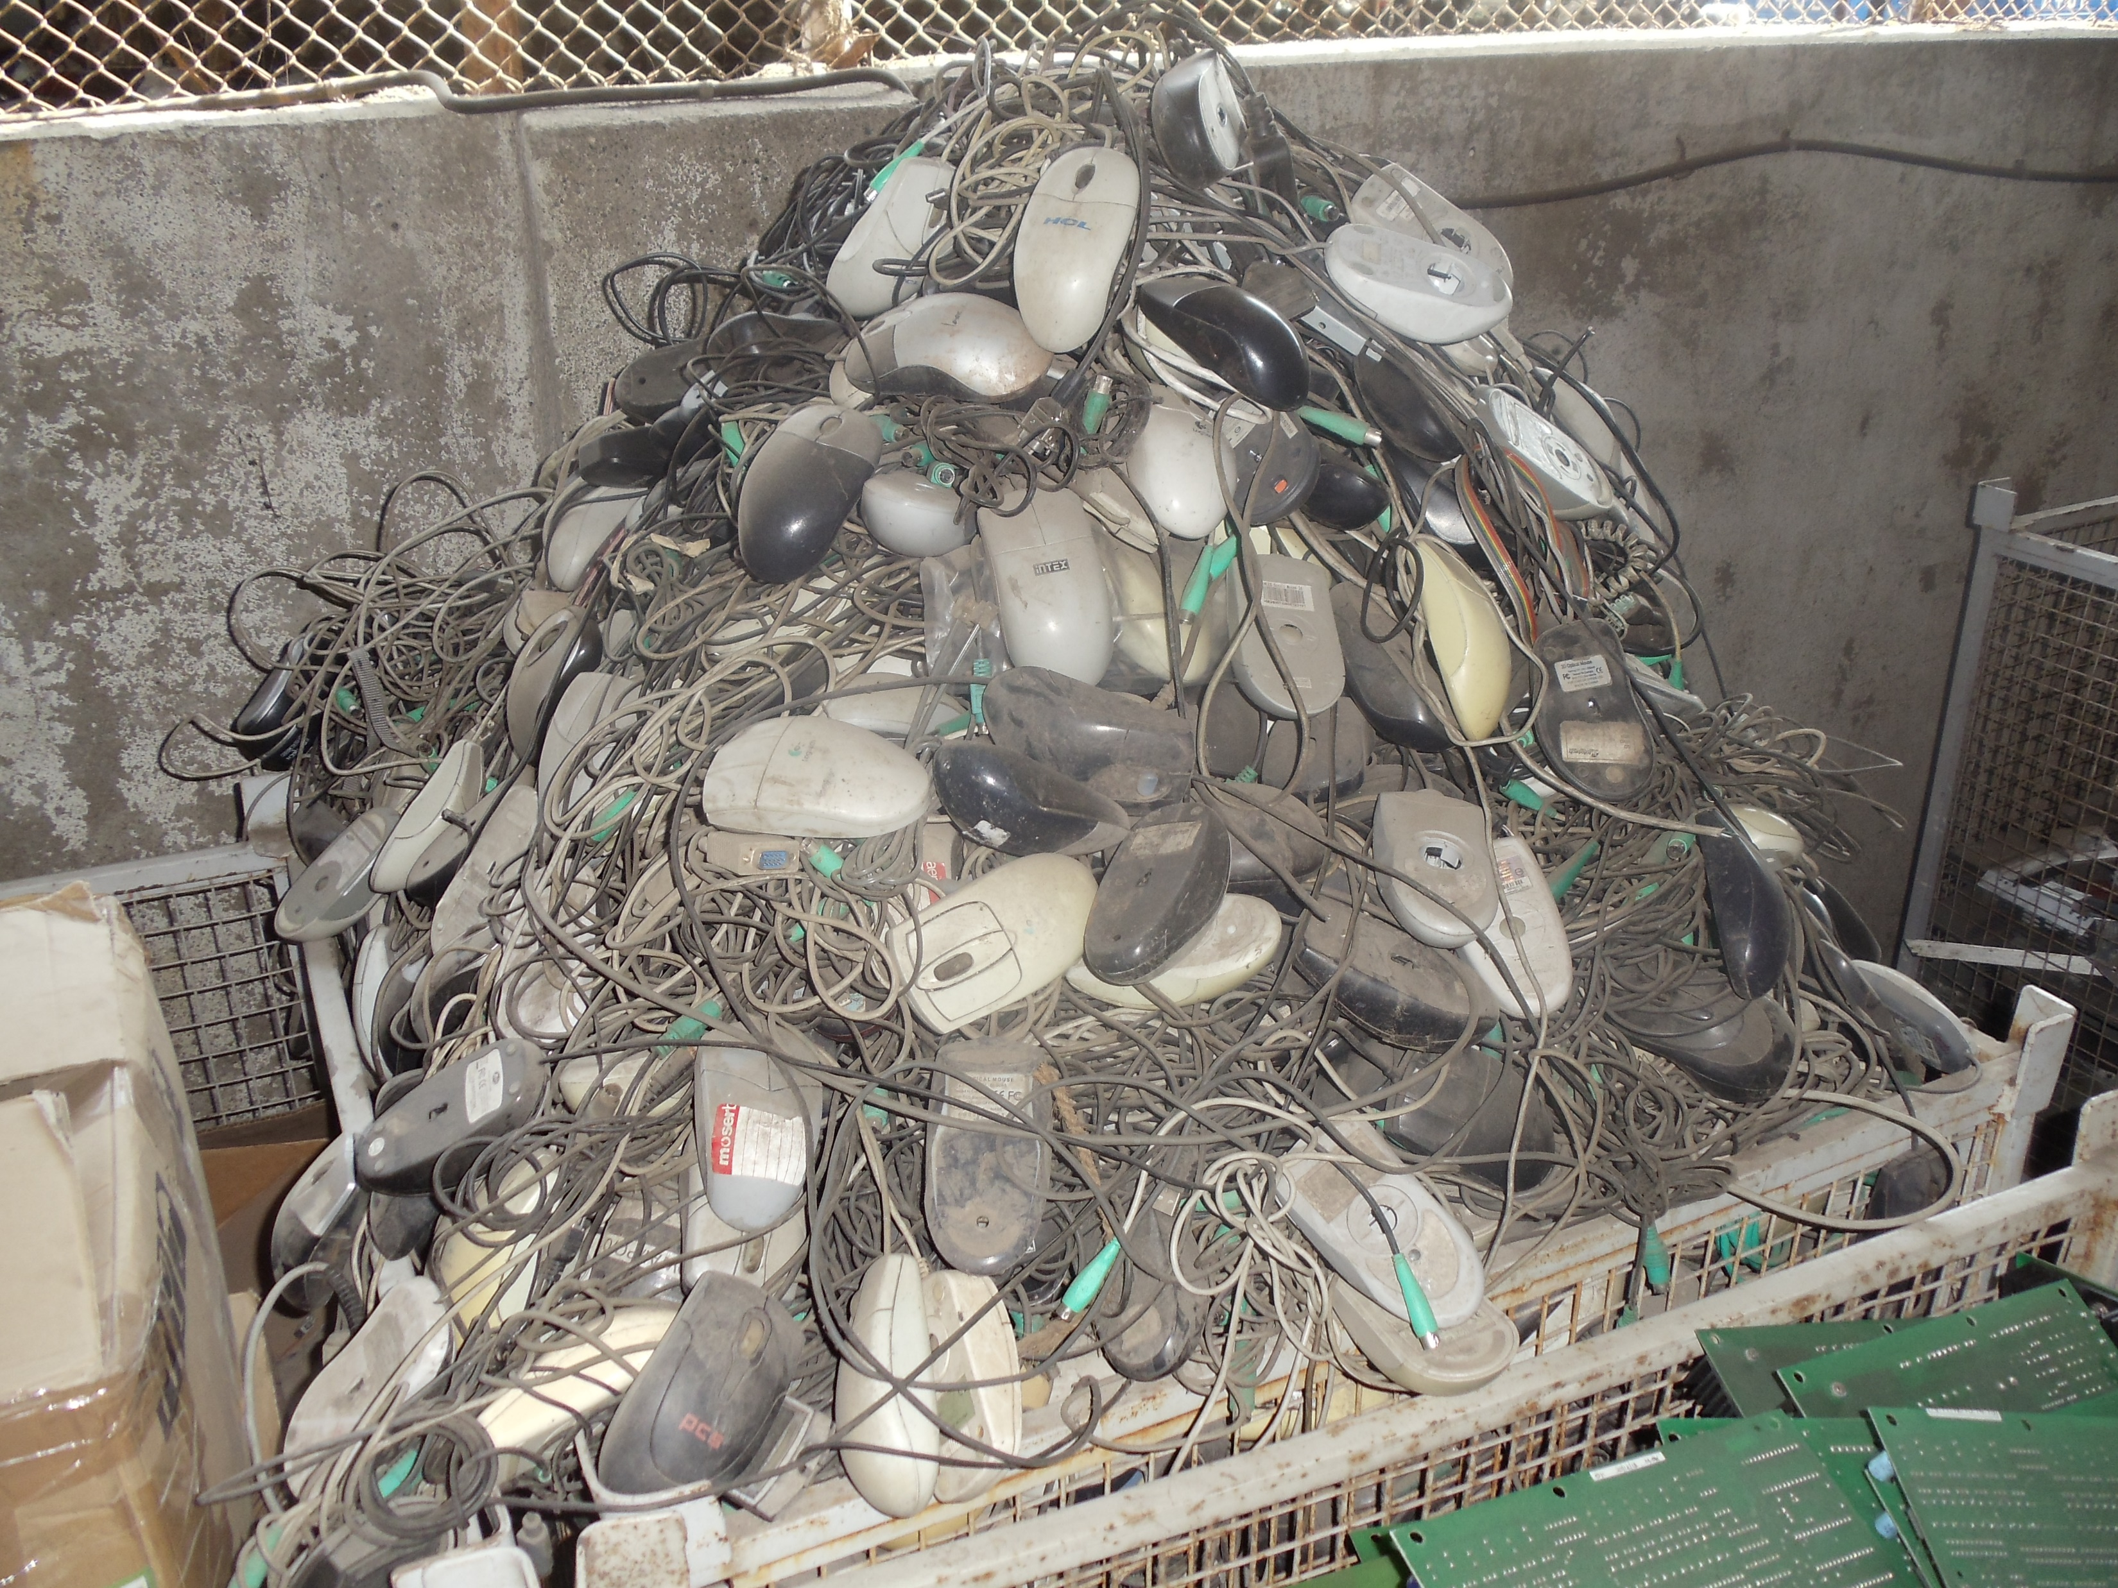
Sustainability/ E-Waste
How can the growing pile/issue of electronic waste be addressed in a sustainable and environmentally friendly way? Dumped into a pile and burnt or buried is not acceptable.
Notes:
15
Left: The office/meeting room at Eco-Reco, a leading Mumbai-based e-waste recycling plant in the northern suburbs near Thane.
Right: A crate of old mice set to be recycled at Eco-Reco (2014).

Slide 16
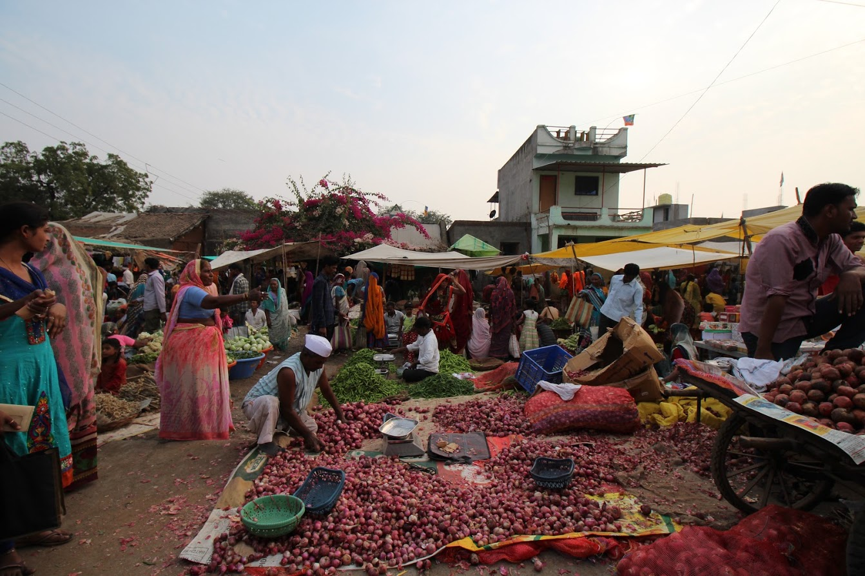
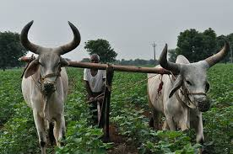

Sustainability/ Farming Livelihoods
10,289 farmer’s have taken their own lives since 2019. 3927 in Maharashtra State.
Notes:
16
Image source National Geographic.

Slide 17


